Slide 1
Core Message: Rule-based systems are a feasible solution for geospatial visualisation recommendation
Intro and Methods:
Background, Problem, Prior work/solutions, Gap
Research Question, Objectives
Implementing visualisation knowledge into a visualisation ranking system, Listing possible geospatial visualisation for a given dataset
Results:
Principles of visualisation, from literature and experimentation
A way to enumerate visualisations
A way to rank visualisations
Limitations and Discussion:
The space of possible visualisations
Conflict between colours on map and colours on encoding
Rule-based requires a lot of manual tweaking
Clustering similar visualisations is important to reduce repetitive visualisations
Properties of the data, eg, correlations between variables, variance, etc important for recommending visualisations
Ensemble encodings with three or more encodings is hard to interpret
Objective: To inform

Slide 2
1. Topic (importance and current problem) 2. Research question 3. Methodology 4. Results so far 5. Discussion and conclusion

Slide 3
Rule-Based Geospatial Visualisation Recommendation
Anthony Joseph Jungo, Kaiza Kunonu Ilomo, John Waithaka

Slide 4
Geospatial visualisation recommendation is a significant research area
Agenda:
1. The topic, and The problem
2. Our aim, and Our approach
3. Results and Discussion
We want to inform you about geospatial visualisation recommendation using a rule-based system

Slide 5
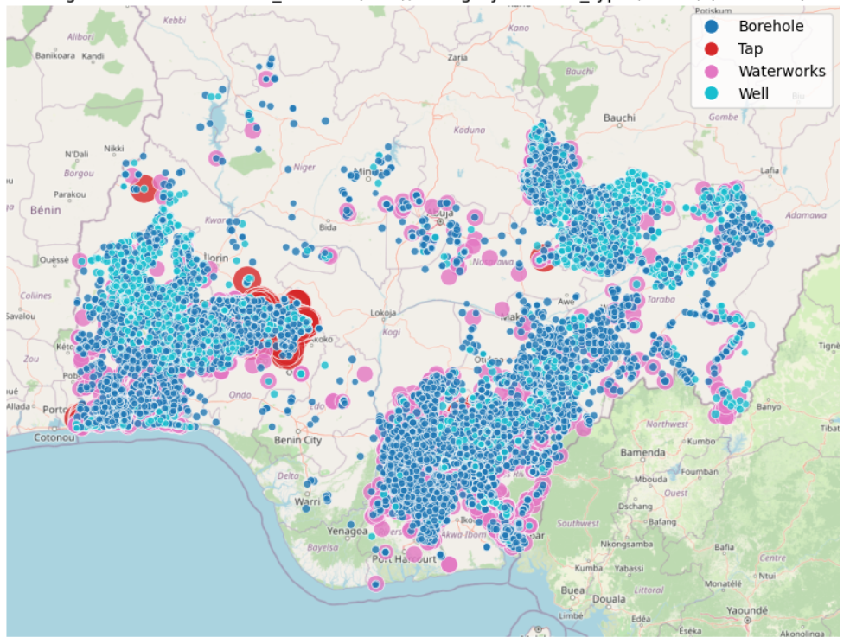
Rule-Based Geospatial Visualisation Recommendation
Geospatial visualisation: Data visualisation overlayed on a map
Recommendation: Automatically identifying the few good visualisations of a given dataset
Rule-Based: Codified knowledge

Slide 6
The Problem
Finding the few useful patterns out of many in a large dataset
Finding effective visualisations of a pattern
Status Quo:
Manual trial-and-error
Fancy inaccessible statistics
Research problem since 1986

Slide 7
Research Question & Objectives
How good are rule-based systems at recommending useful and communicative geospatial visualisations for a given dataset?
Previous works use rule-based systems to recommend data visualisations like bar graphs and scatter plots. Would this work for geospatial visualisations?

Slide 8
Methodology
Principles for effective visualisation
Codifying principles into a visualisation ranking system
Developing a method of enumerating a diverse set of geospatial visualisations
Combining the ranking and enumeration functions into a geospatial visualisation recommendation system
Based on previous work on visualising bar graphs, scatter plots, etc.

Slide 9
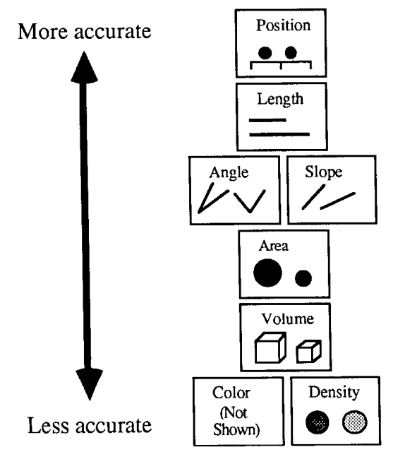
Results (1/2)
1, 2
Principles and knowledge on effective data visualisation
Primitive visual encodings:^{1, 2}
Q: Area, Colour hue, Colour intensity
C: Colour hue, Shape
Ranking:
Area > Colour for quantitative data ²
Colour > Shape for categorical data¹
1. J. Mackinlay, ‘Automating the design of graphical presentations of relational information’, ACM Trans. Graph., 1986.
2. W. S. Cleveland and R. McGill, ‘Graphical Perception: Theory, Experimentation, and Application to the Development of Graphical Methods’, Journal of the American Statistical Association, 1984.
3. J. Bertin, Semiology of Graphics: Diagrams, Networks, Maps. ESRI Press, 2011.

Slide 10
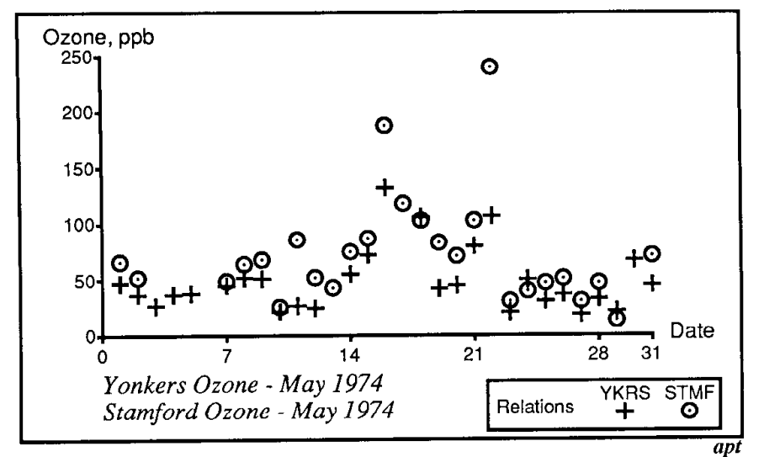
Results (2/2)
Codifying principles into a visualisation ranking system
Each primitive visual encoding has a set score based on its rank
A visualisation’s score is an aggregate of its constituent encodings’ scores
1
Enumerating possible geospatial visualisations
Match each data variable with all valid visual encoding
Compose a permutation of the result
1. J. Mackinlay, ‘Automating the design of graphical presentations of relational information’, ACM Trans. Graph., 1986.

Slide 11
Demo

Slide 12
Discussion
You can’t find useful patterns without looking at the data itself (distribution, correlations, trends etc.)
Little published knowledge on geospatial visualisation
Navigating the space of possible visualisations for large datasets
Ensemble visual encodings
User intent and context as input.
Clustering to reduce repetitive recommendations.
Feasibility of a machine learning solution (data)

Slide 13
Conclusion
Rule-based geospatial visualisation recommendation is codifying visualisation knowledge to identify the few useful and communicative geospatial visualisations for a given dataset
To assess the effectiveness of rule-based systems for geospatial visualisation, we attempt to develop it in two parts – ranking and enumeration subsystems.
We find that data type alone is not enough to identify good visualisations, and that there are many research questions in this area worth exploring.

Slide 14
Thank you
Q&A

Slide 15
References
J. Mackinlay, ‘Automating the design of graphical presentations of relational information’, ACM Trans. Graph., 1986.
W. S. Cleveland and R. McGill, ‘Graphical Perception: Theory, Experimentation, and Application to the Development of Graphical Methods’, Journal of the American Statistical Association, 1984.
J. Bertin, Semiology of Graphics: Diagrams, Networks, Maps. ESRI Press, 2011.

Slide 16
Prior Work – On Effective Visualisation
[Principles of visualisation]
Bertin on the primitive visual encodings
Cleveland and McGill on the accuracy of perceptual interpretation.
Work on ensemble encodings

Slide 17
Prior Work–On Recommending Visualisations
ML-Based
Good performance, but…
High data requirements
Black box – difficult to interpret (Neural Nets)
Rule-Based
Implementation of design principles for ranking visualisations
Listing possible visualisations
Filtering and ranking
No one has looked at the recommendation of map visualisations

